Slide 1


STAT1000J
Data Science for Future Engineers
SP2024 Spring 2024
Unraveling the Factors Related to Sleep Duration
Group 4
Zhuoxiao Zhang: Data Exploration, Visualizations
Wenjun Cheng: Topic selection, Predictive Model
Junyu Fan: Hypothesis Testing, PPT making

Slide 2

Contents
01. Motivation
02. Goals
03. Data exploration
04. Hypothesis testing
05. Predictive model
06. Conclusion

Slide 3

Motivation
Sleeping: an increasingly crucial problem
What factors are related to the sleep duration?
Inspirations to potential sleep problems

Slide 4
Goals
· Find some simple correlations between sleep duration and other factors with numerical values.
· Examine the specific relationship between ‘body fitness’ and ‘sleep duration’.
· Create a predict model between ‘sleep duration’ and [‘age’, ‘physical activity level’, ‘stress level’].

Slide 5

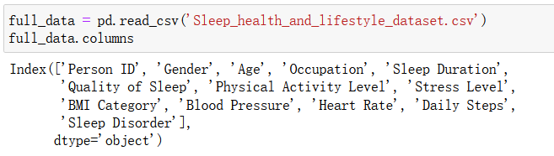



Data exploration
We find a dataset in Kaggle [1] with these columns:
Sleep duration, Sleep Quality
Age, occupation, sex, physical activity levels, stress levels, BMI categories, blood pressure, heart rate, and daily steps.

Slide 6
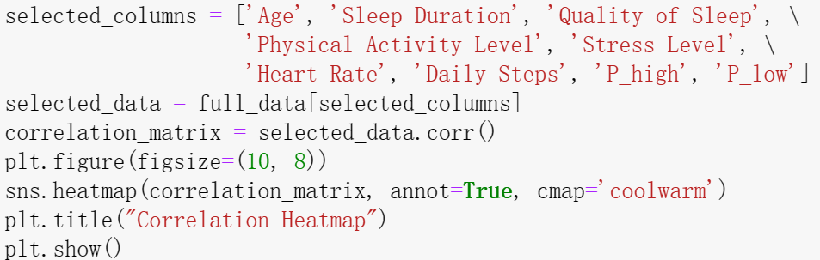
Data exploration
We use .corr() and sns.heatmap() to create this Correlation Heatmap.
(Only include the numeric factors)
P_high means the high blood pressure
P_low means the low blood pressure

Slide 7
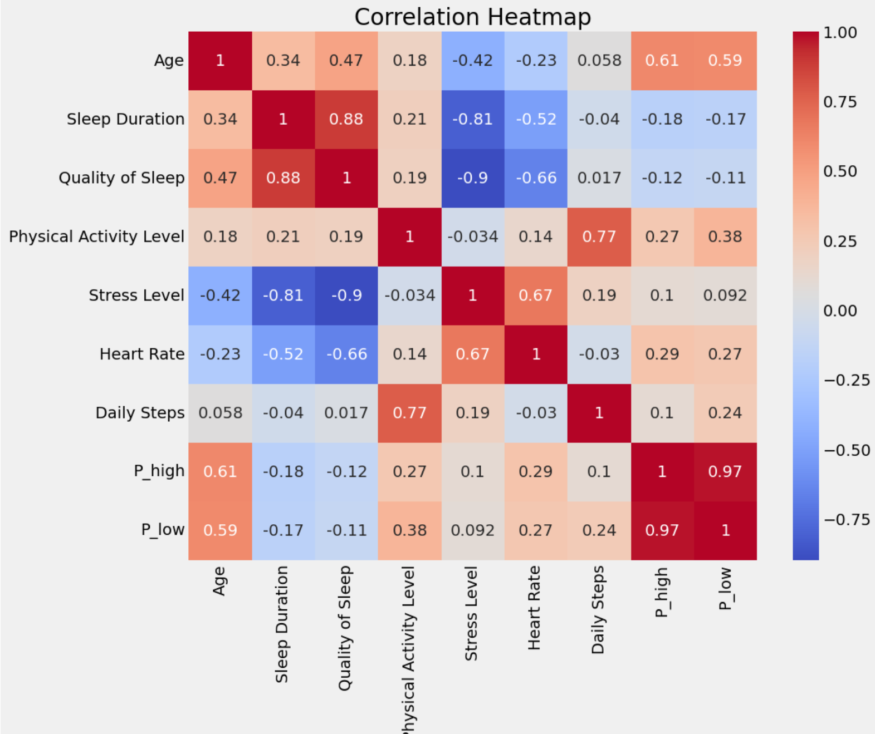
Data exploration
The sleep duration is highly correlated with the quality of sleep. and stress level.(0.88 and -0.81)
P_high means the high blood pressure
P_low means the low blood pressure

Slide 8
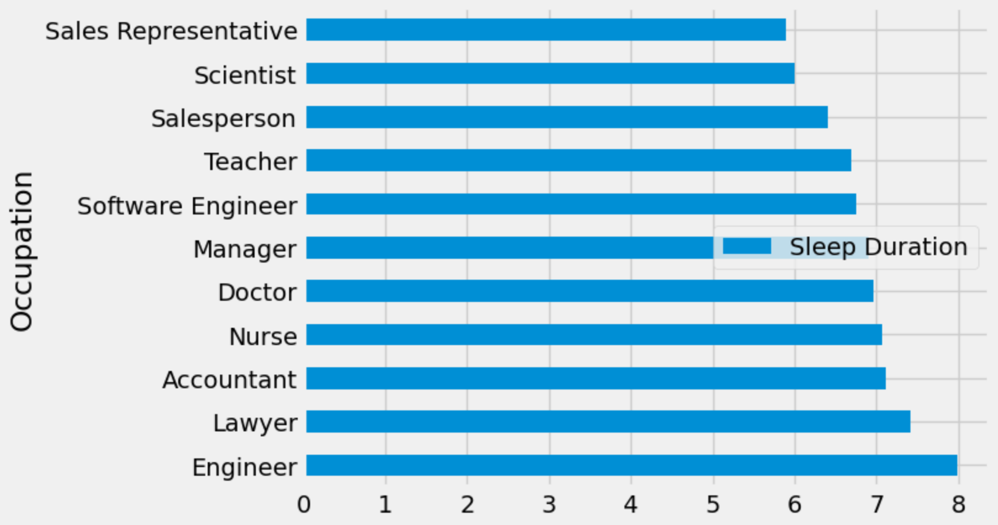

Data exploration
The relationship between sleep duration and occupation
Wow!
Interesting!

Slide 9
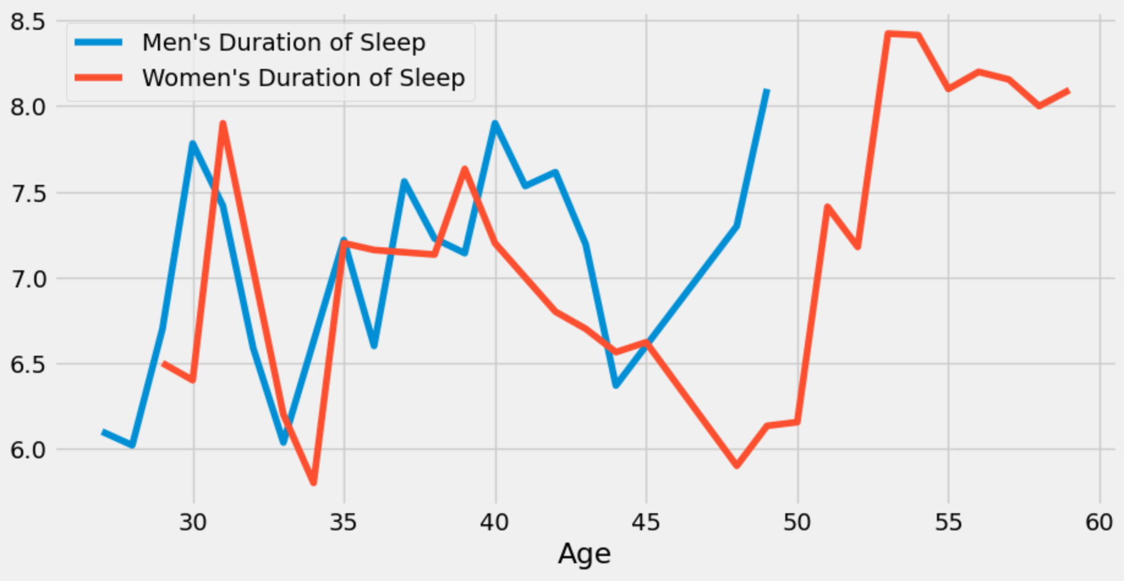
Data exploration
·Higher age does not necessarily lead to lower sleep duration.
·The difference for sleeping duration is not very significant for two genders.
·Both male and female participants show a age of significantly lower sleeping duration.
For both male and female, the lowest point is around age 34.

Slide 10
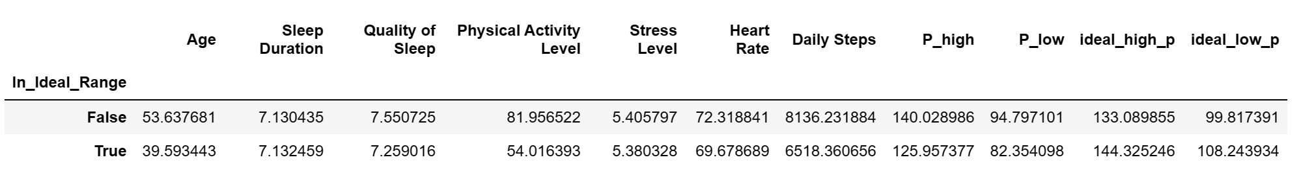
Data exploration
This is the mean values of the population whose blood pressure is healthy or not. (True means the blood pressure is in the ideal range)
The sleep duration is similar in two groups. This result is beyond our expectation.☺
So maybe there isn’t a strong relationship between them.

Slide 11
Hypothesis testing
We want to test the relationship between fitness (BMI) and sleep duration:
Null Hypothesis:
There is no relationship between ‘higher weight’ and ‘Sleep duration’.
Alternative Hypothesis:
‘Higher weight’ relates to lower ‘Sleep duration’.

Slide 12
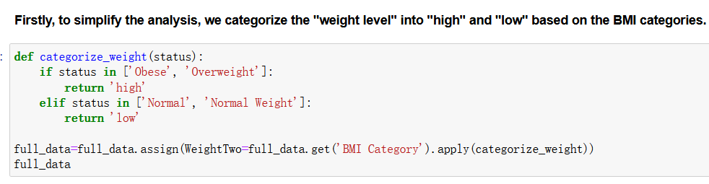
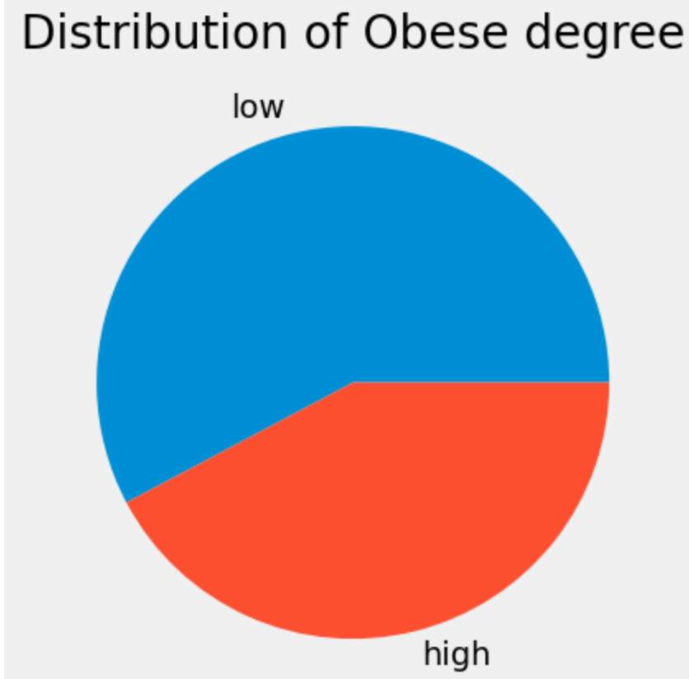
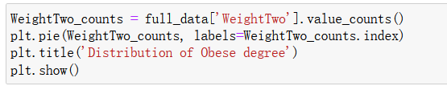
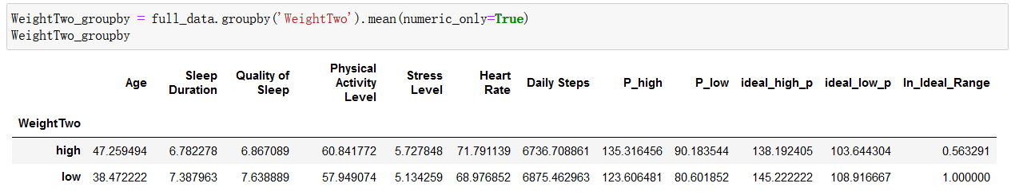
Hypothesis testing

Slide 13
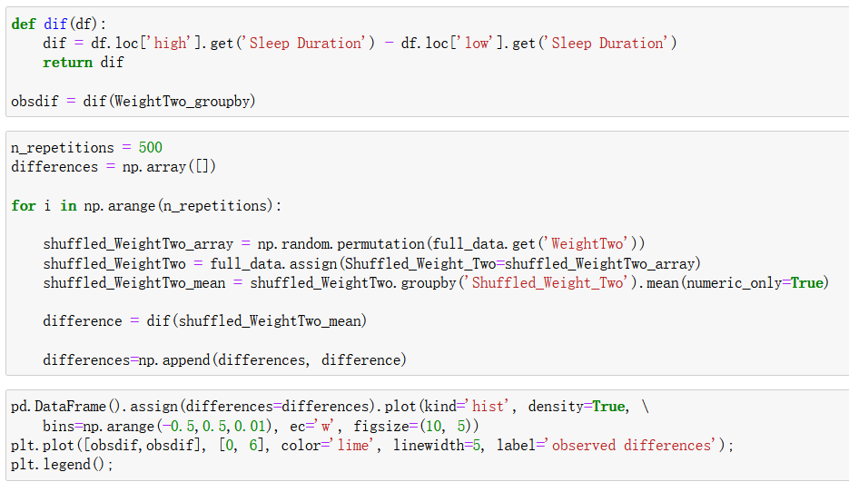
Hypothesis testing

Slide 14
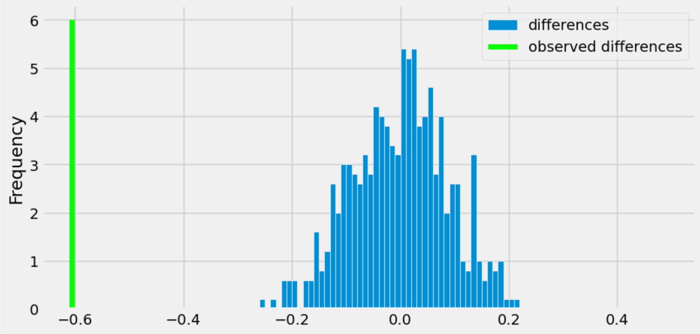
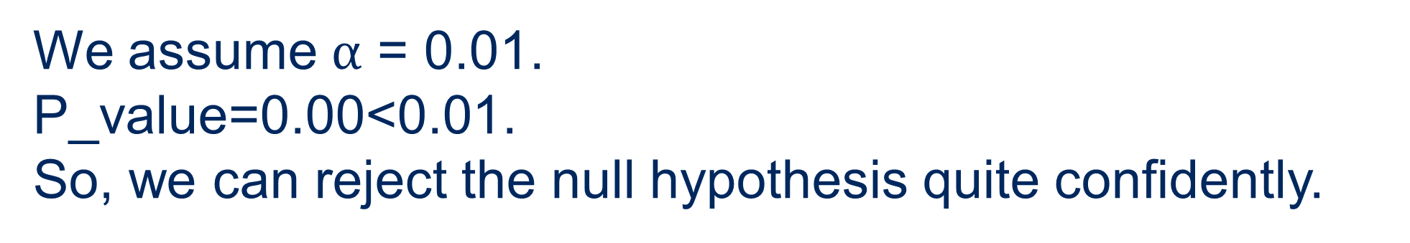
Hypothesis testing
We assume $α$ = 0.01.
P_value=0.00<0.01.
So, we can reject the null hypothesis quite confidently.
Permutation test

Slide 15
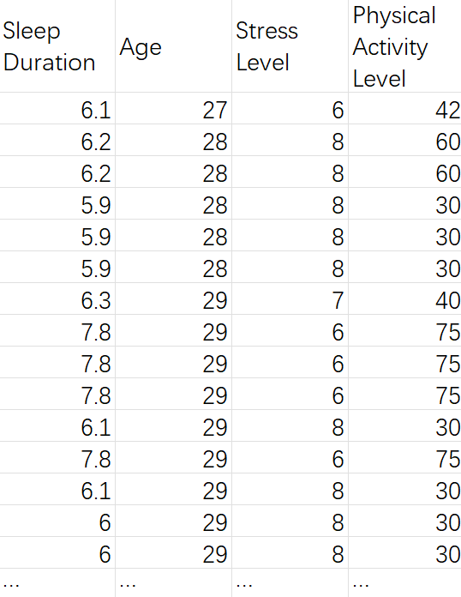




Predictive model
Sleep Duration = -0.00326 * (Age) -0.36746 * (Stress Level) + 0.007286 * (Activity Level)

Slide 16
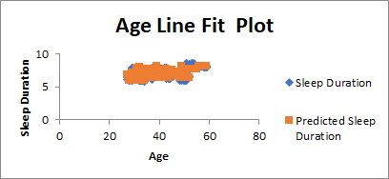
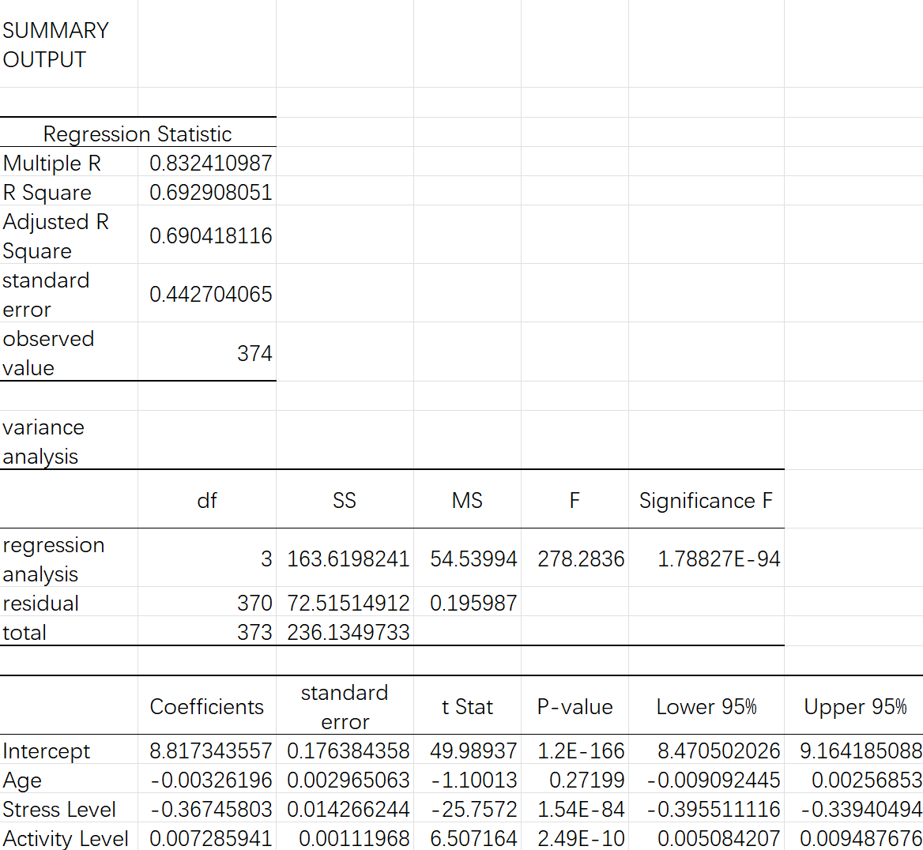
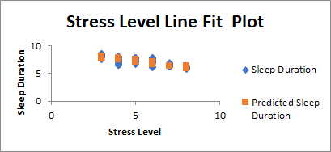
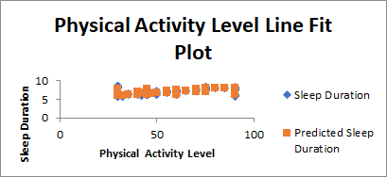
Predictive model
Sleep Duration = -0.00326 * (Age) -0.36746 * (Stress Level) + 0.007286 * (Activity Level)

Slide 17
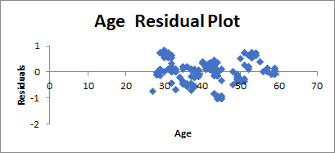
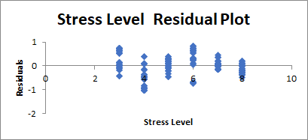
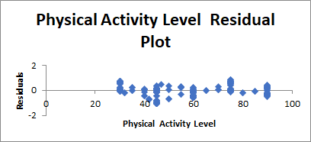
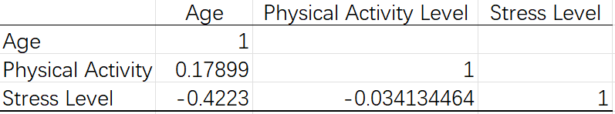
Predictive model
Sleep Duration = -0.00326 * (Age) -0.36746 * (Stress Level) + 0.007286 * (Activity Level)
· No outlier
No high leverage point
Inside +/- 3 std
· No multicollinearity (|pairwise correlation|<0.7)

Slide 18
Conclusion
· Interesting findings: Engineers have a relatively long sleep.
· Sleep duration has some specific relationship to sleep quality, age, sex, occupation and stress level.
· Hypothesis test result: People with higher BMI tend to sleep less.
· Sleep duration can be predicted by calculating three elements (age, physical activity level, and stress level).

Slide 19
Conclusion
Suggestions:
Ease your stress to sleep longer!
Take more physical activities!
If you want to sleep longer, be an engineer.

Slide 20
References
[1] Sleep Health and Lifestyle Dataset (kaggle.com)

Slide 21

Hope everyone sleep well!

